Slide 1
Linux Operating System
Practical Guide to Linux Commands, Editors, and Shell Programming, A (3rd Edition) by Mark Sobell
Unit 1: An Introduction to Linux
Chapter 2: Installation Overview
Copyright © 2012, Fred R. McClurg, All Rights Reserved

Slide 2
Distributions
A distribution is a “flavor” of Linux. All of them use the same OS version 2.6 kernel.
Fedora
Ubuntu
Mint
openSUSE

Slide 3
Fedora Desktops
A desktop is a window manager that uses a particular GUI library.
Fedora (fedoraproject.org)
Gnome (Default)
KDE
LXDE
Xfce

Slide 4
Ubuntu Desktops
A desktop is a window manager that uses a particular GUI library.
Ubuntu (www.ubuntu.com)
Gnome (Default)
KDE (Kubuntu)

Slide 5
Mint Desktops
A desktop is a window manager that uses a particular GUI library.
Mint (linuxmint.com)
Mate
Cinnamon
KDE
Xfce

Slide 6
openSUSE Desktops
A desktop is a window manager that uses a particular GUI library.
openSUSE (opensuse.org)
KDE (default)
Gnome

Slide 7
OS Virtualization
Operating System (OS) Virtualization is software that allows you to install an operating system as an application. It is like running an OS in a window.
VMware Player
www.vmware.com/products/player
Oracle VirtualBox
virtualbox.org

Slide 8
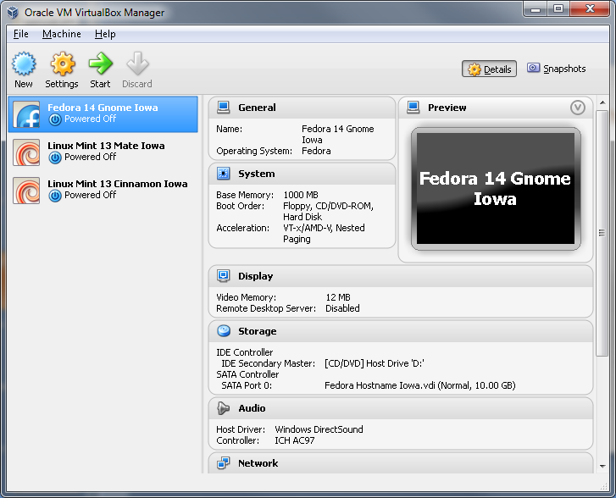
Running VirtualBox

Slide 9
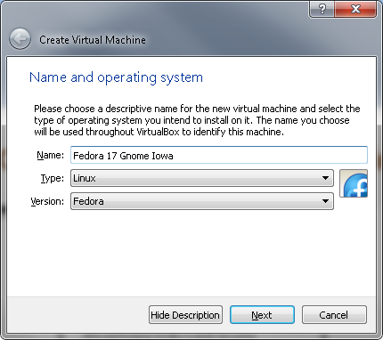
Creating New Virtual Machine
Machine => New...

Slide 10
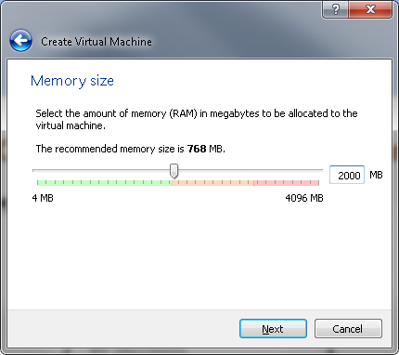
Memory Size

Slide 11
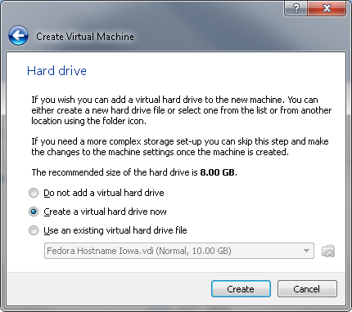
Creating Virtual Hard Drive

Slide 12
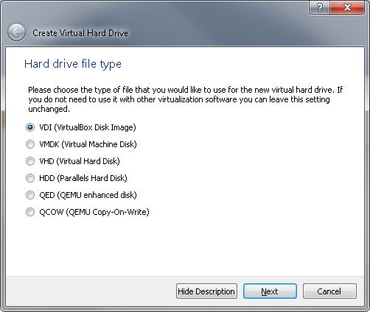
Hard Drive File Type

Slide 13
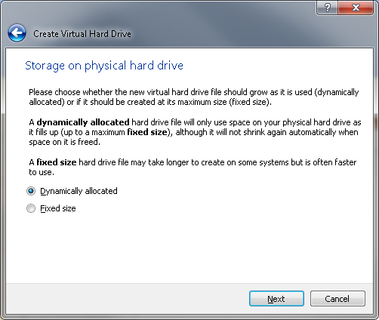
Storage on Physical Hard Drive

Slide 14
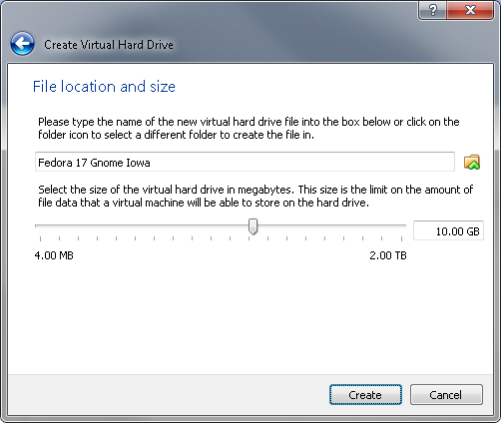
Name the Virtual Machine

Slide 15
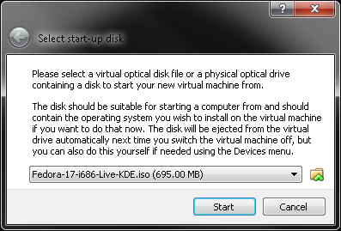
Name the Virtual Machine

Slide 16
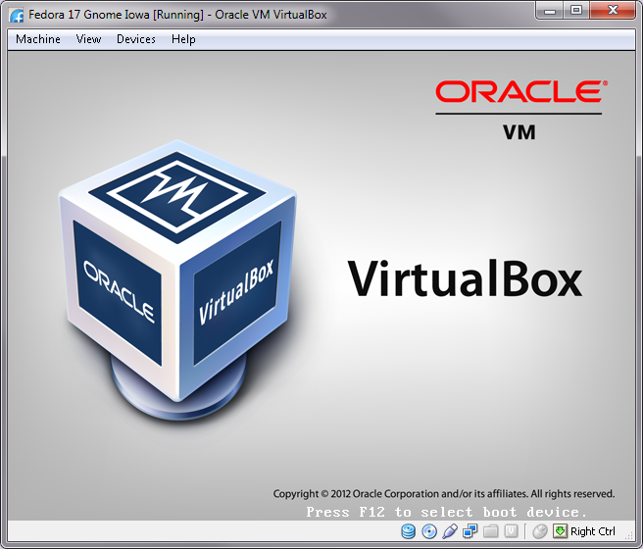
Virtual Machine Power Up

Slide 17
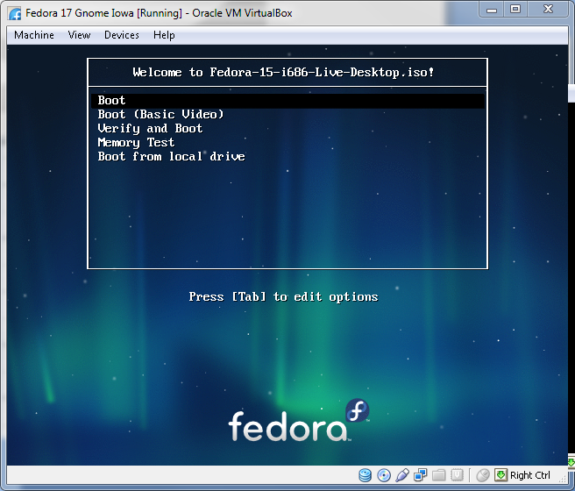
Virtual Machine Running

Slide 18
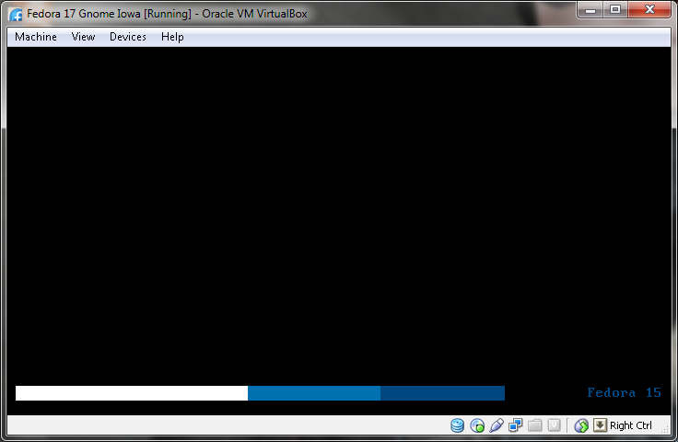
Fedora Startup

Slide 19
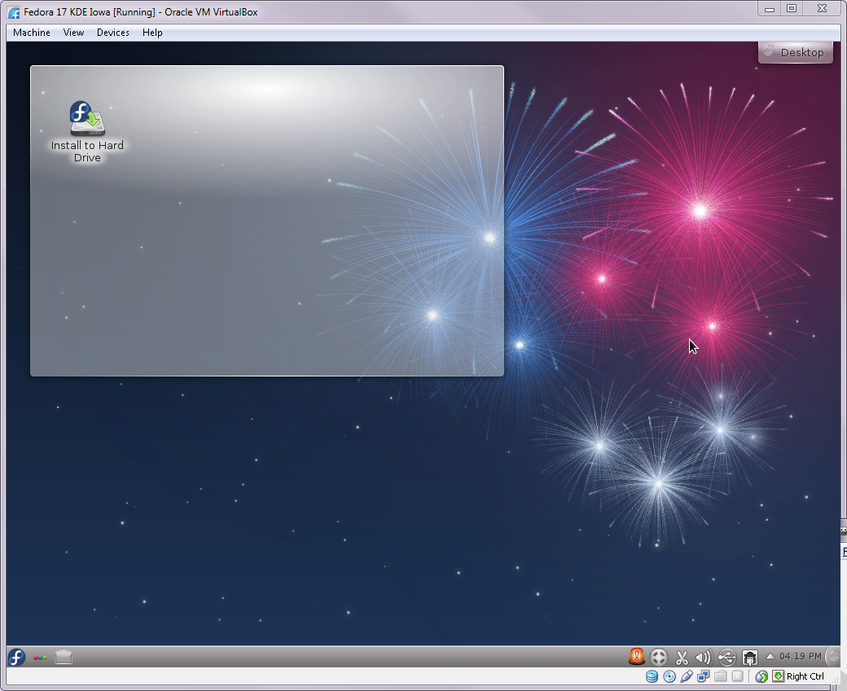
Fedora Live Desktop

Slide 20
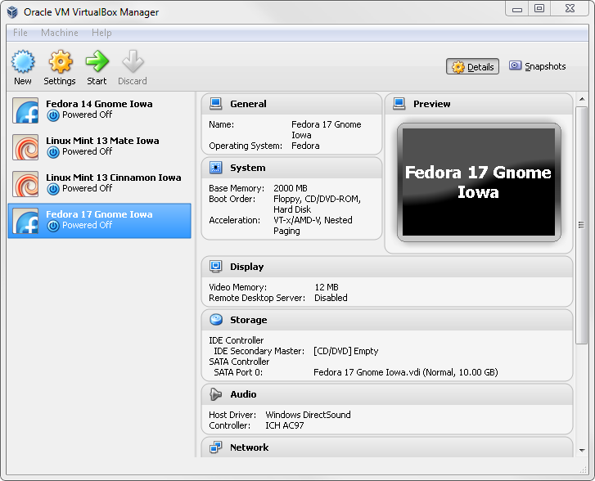
VirtualBox Settings
Machine => Settings...

Slide 21
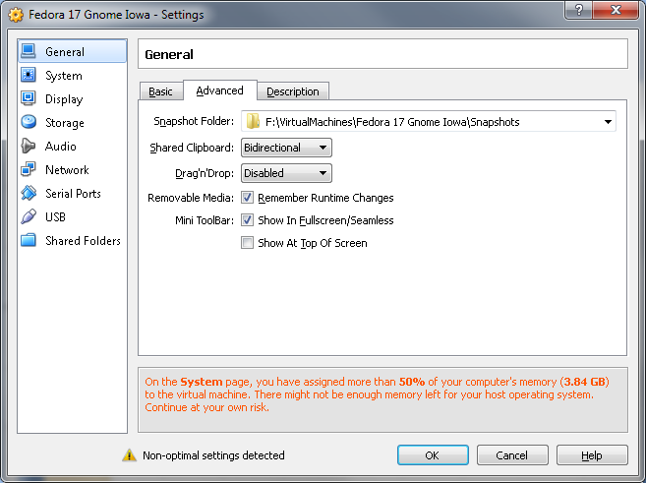
General Settings

Slide 22
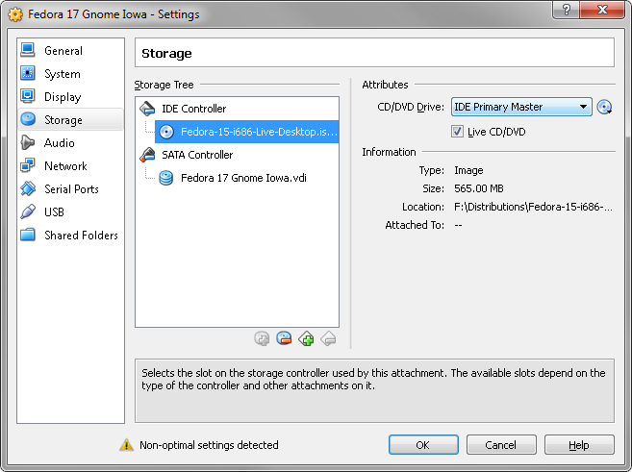
Storage Settings

Slide 23
Starting a Virtual Machine
Machine => Start

Slide 24
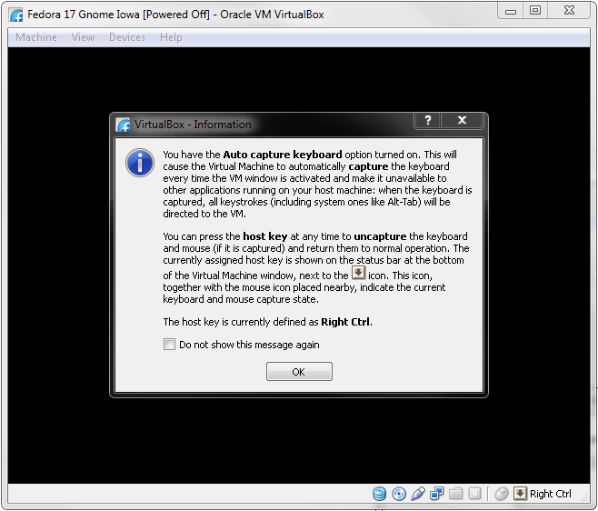
Virtual Machine Power Up

Slide 25
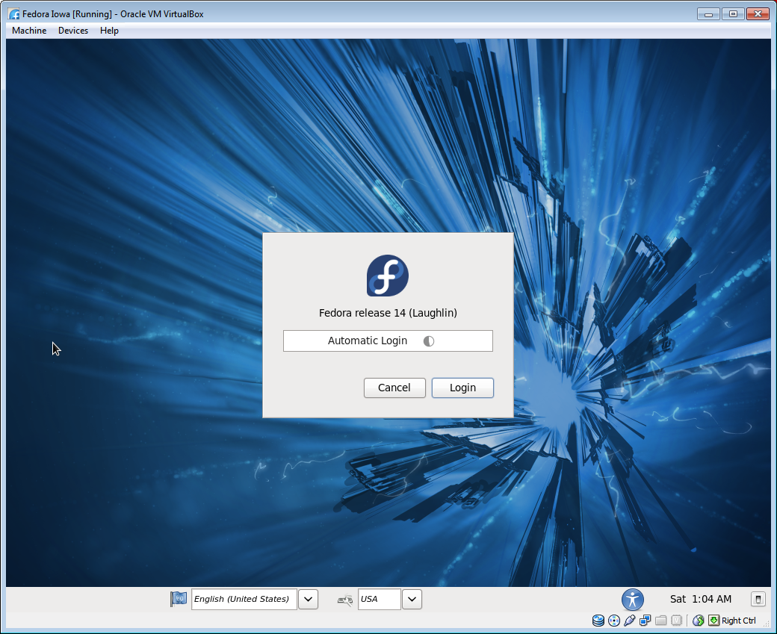
Fedora Automatic Login

Slide 26
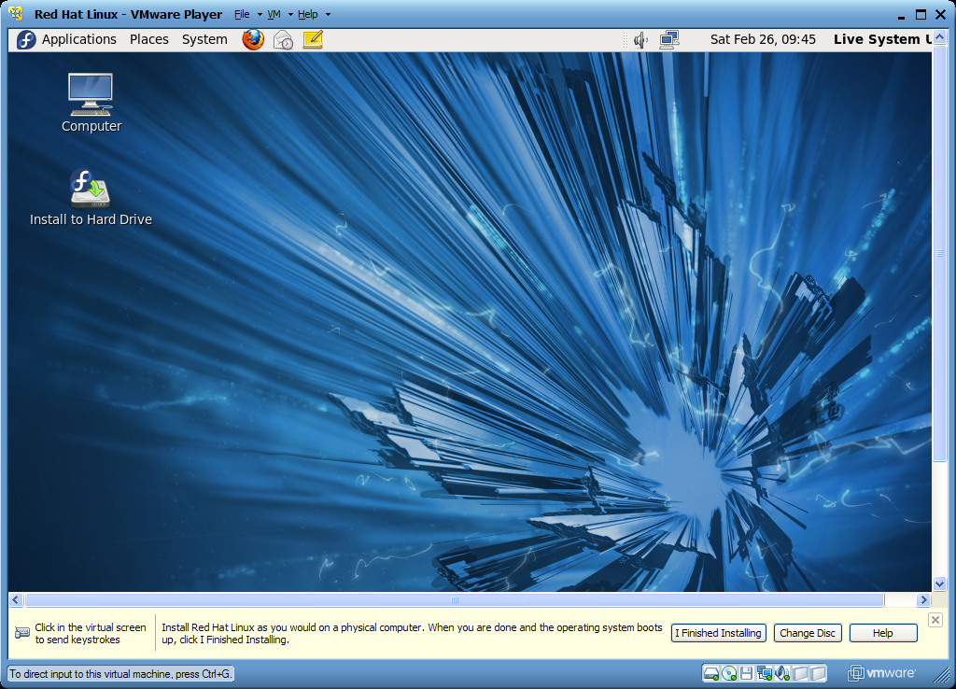
Fedora Live Desktop

Slide 27
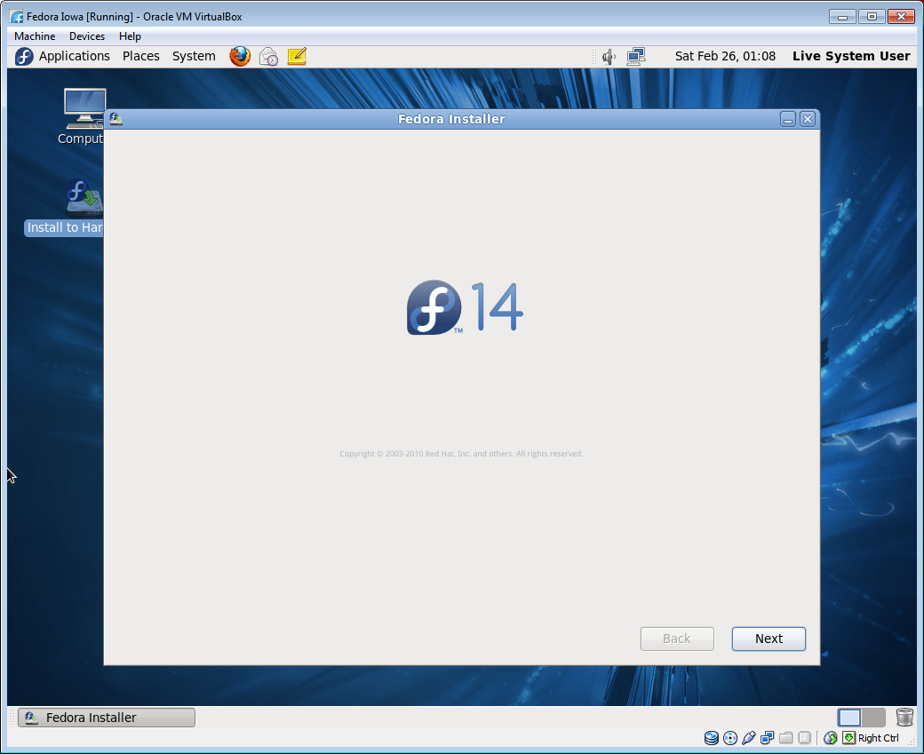
Installer Welcome Screen

Slide 28
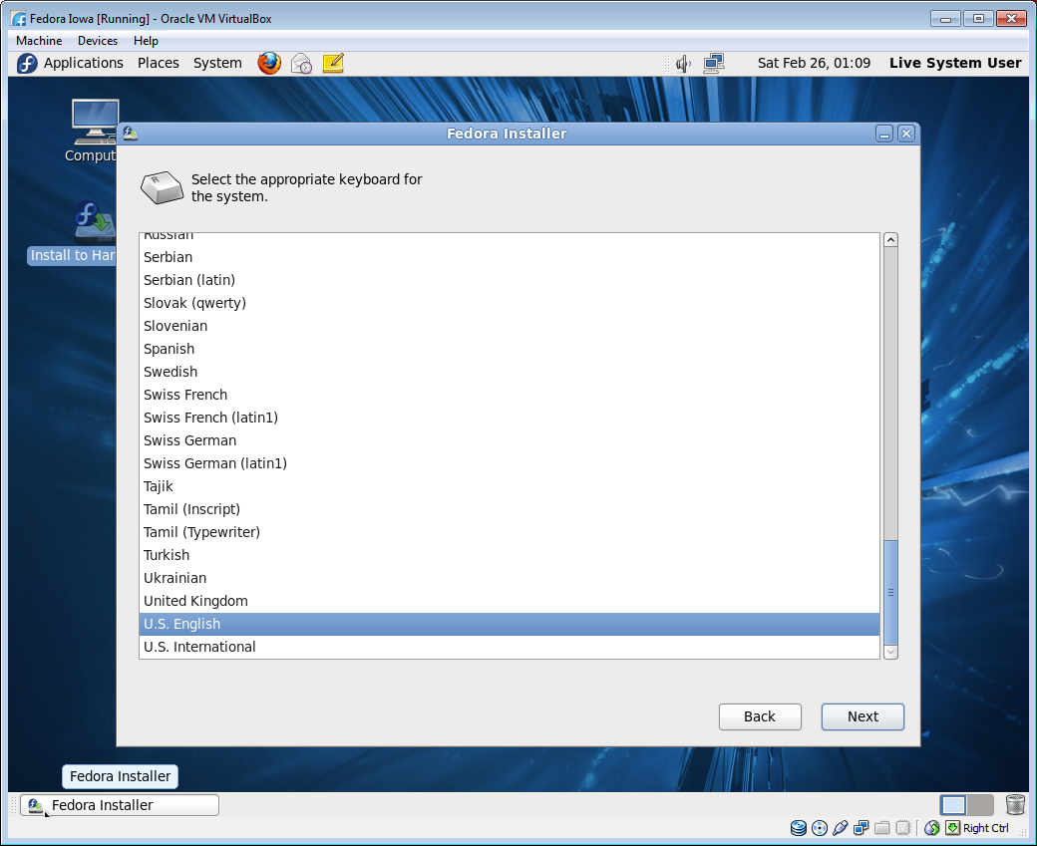
Keyboard Language

Slide 29
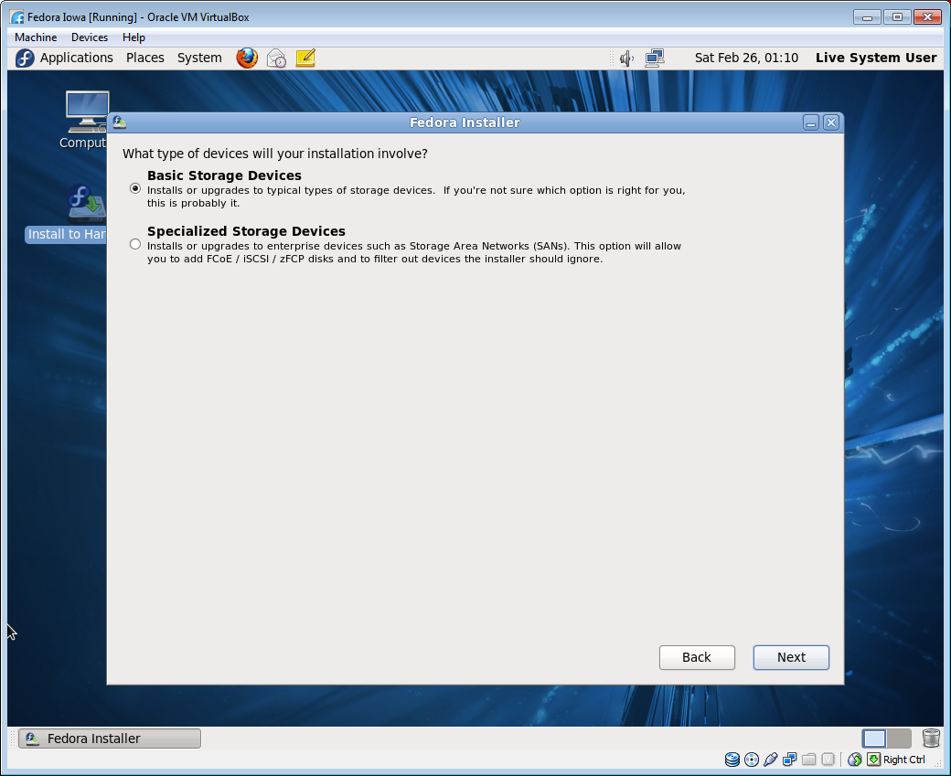
Storage Device Type

Slide 30
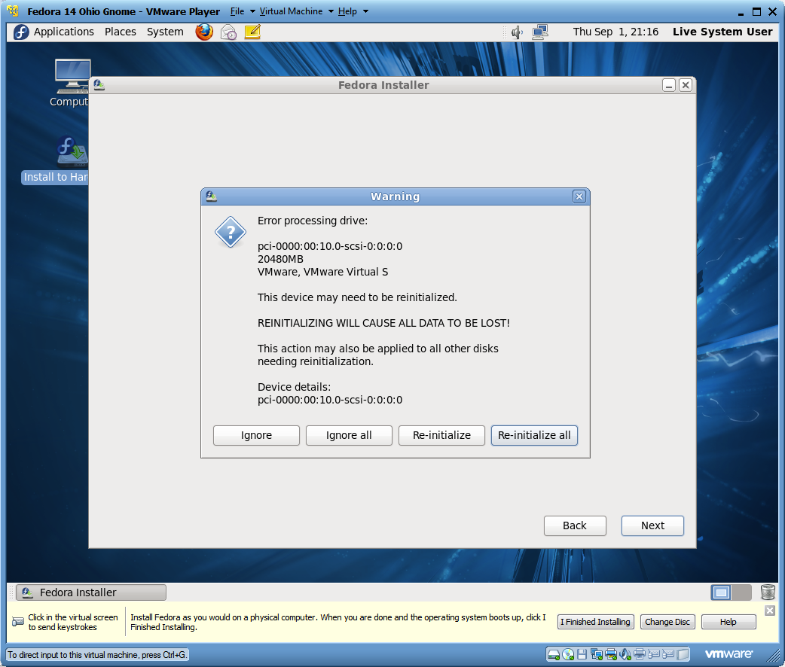
Error Processing Drive

Slide 31
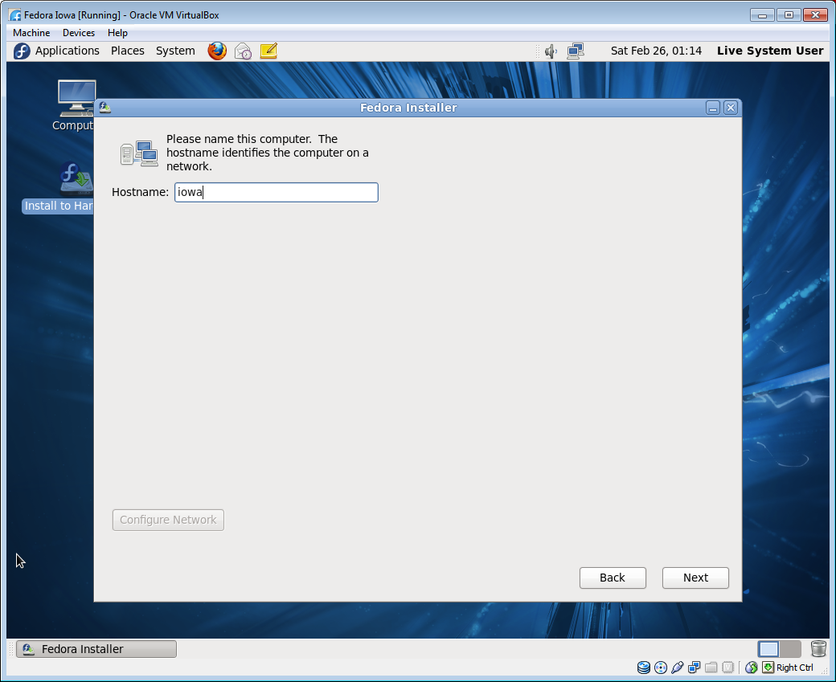
Computer Hostname

Slide 32
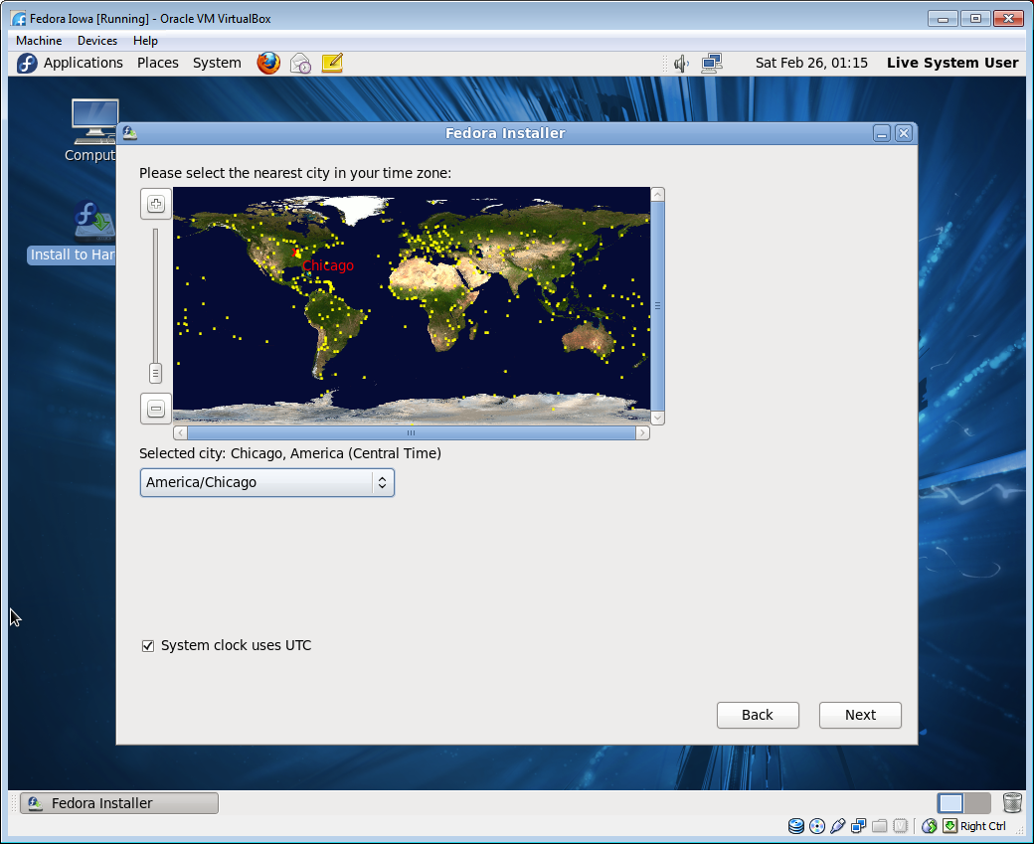
City in your Time Zone

Slide 33
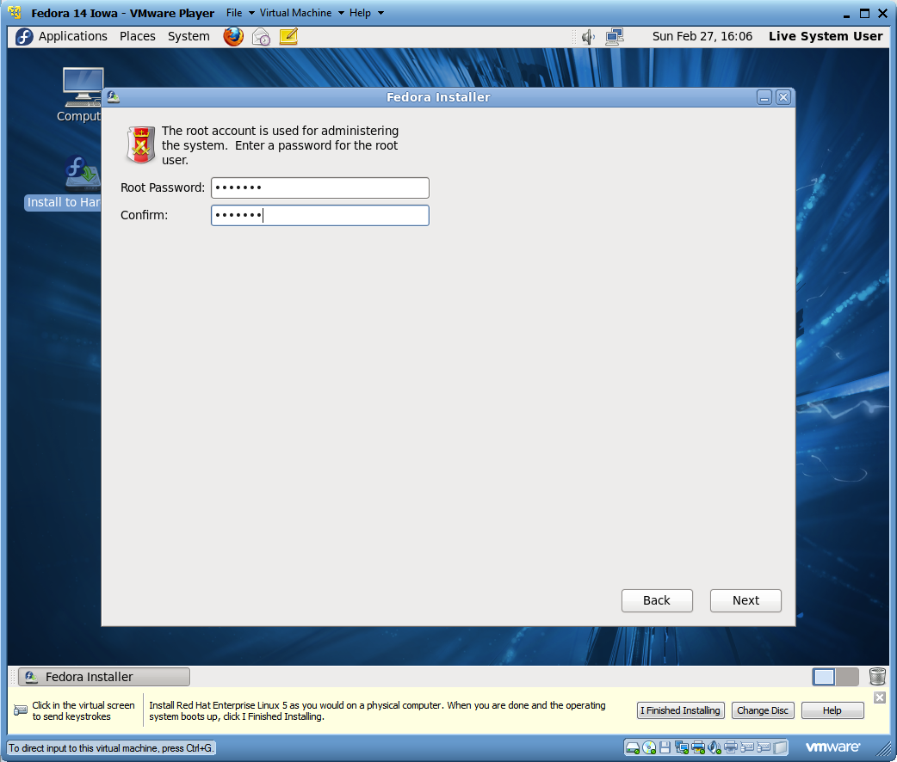
Setting Root Password

Slide 34
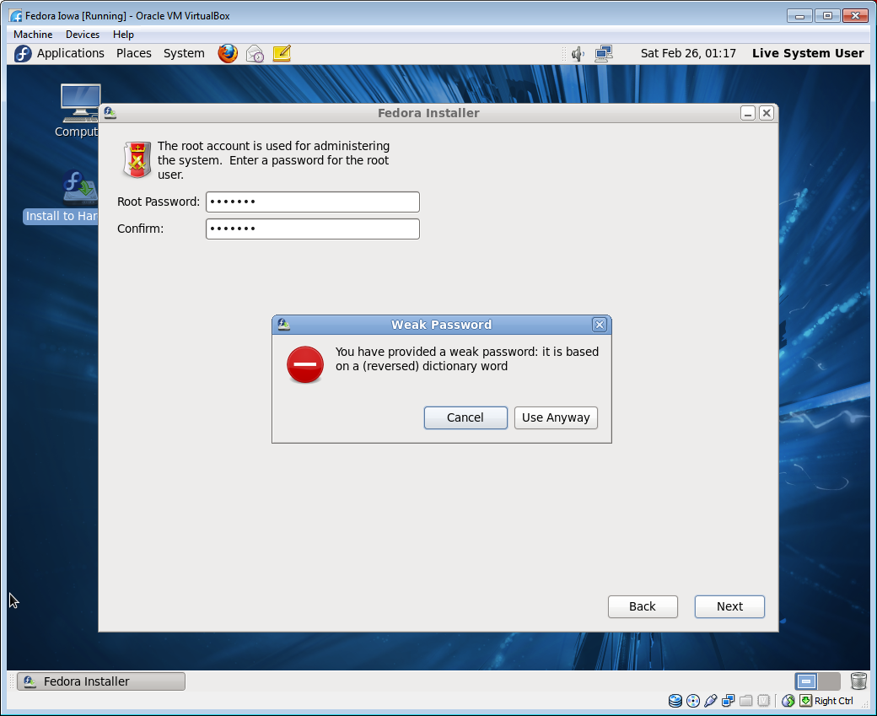
Weak Password Warning

Slide 35
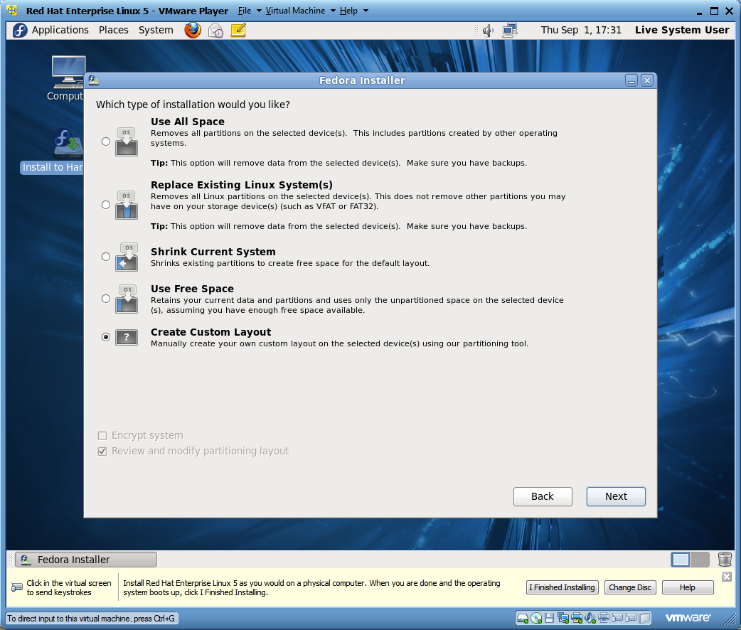
Partitioning Layout

Slide 36
Partitions
/
The slash “/” is the root partition in Linux
/boot
The boot partition is the location of the kernel used to start the operating system
/home
The home partition is the location of the user accounts
swap
The swap partition is used when memory is full
Partition | Purpose
/ | The slash “/” is the root partition in Linux
/usr | Location of executable binaries and documentation
/var | Contains spool directories for mail and printing. Also contains error logs
/tmp | Where many applications store temporary data files
/boot | Location of the kernel used to start the operating system
/home | Location of the user accounts
swap | Swap partition is used when memory is full

Slide 37
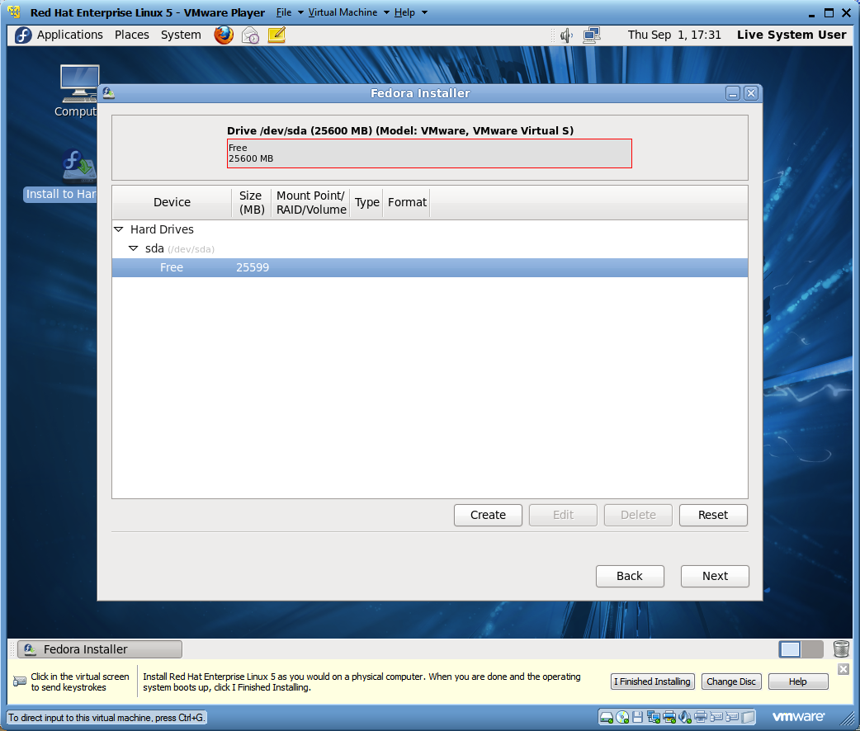
Specify Partition Sizes

Slide 38
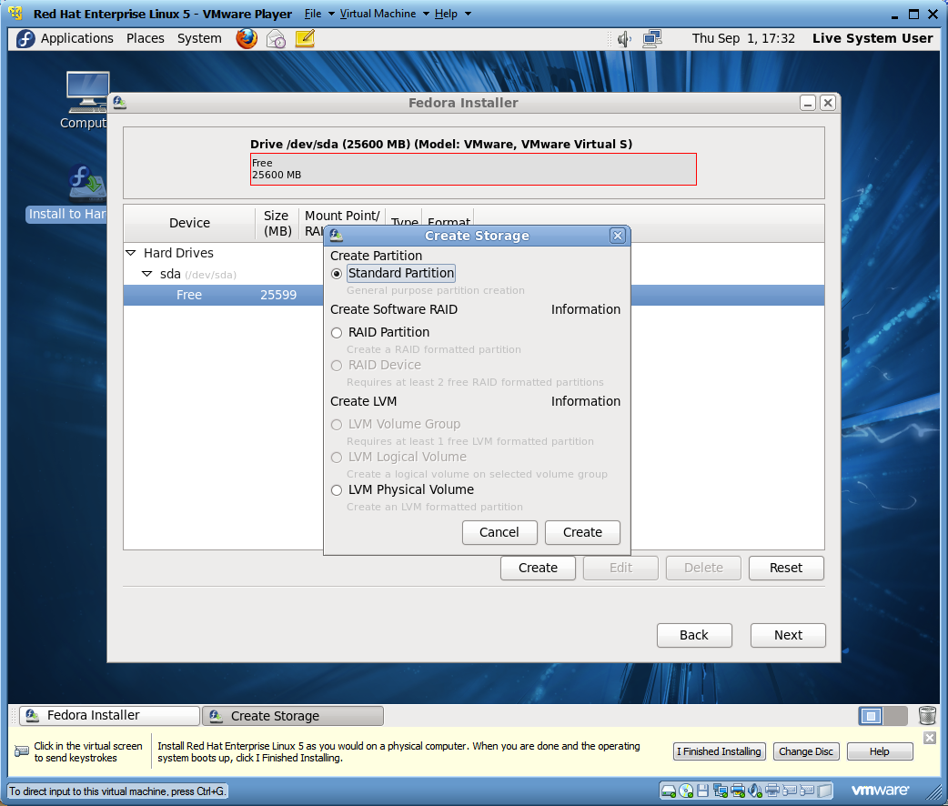
Creating a Standard Partition

Slide 39
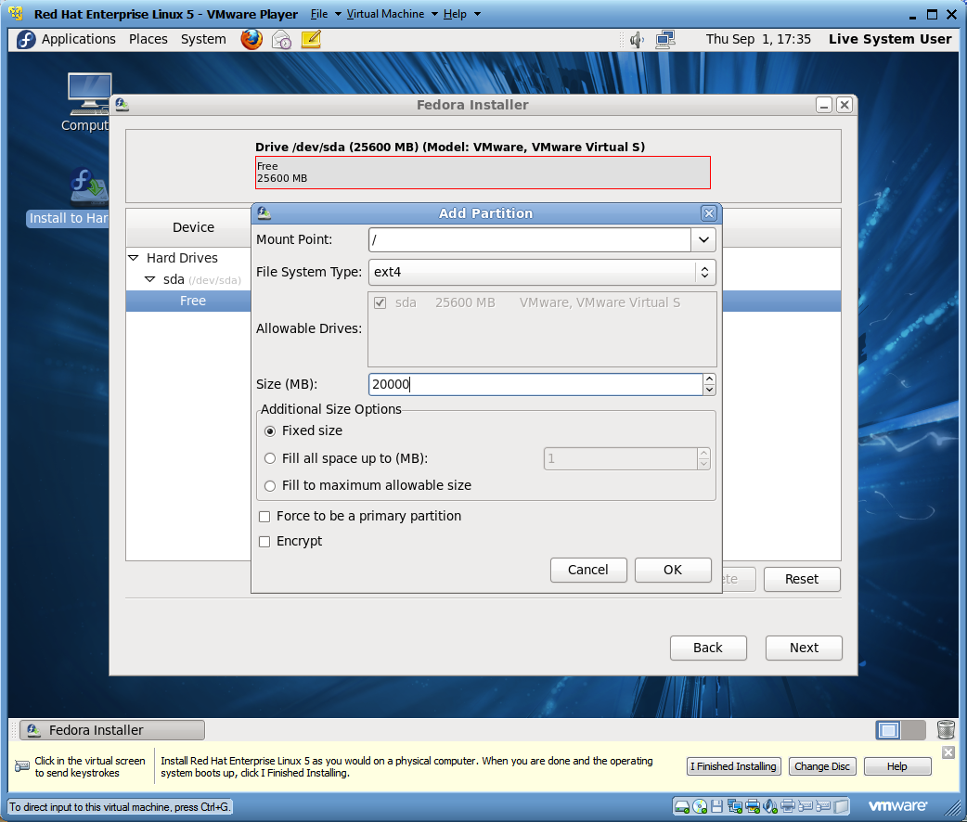
Editing the Root Partition

Slide 40
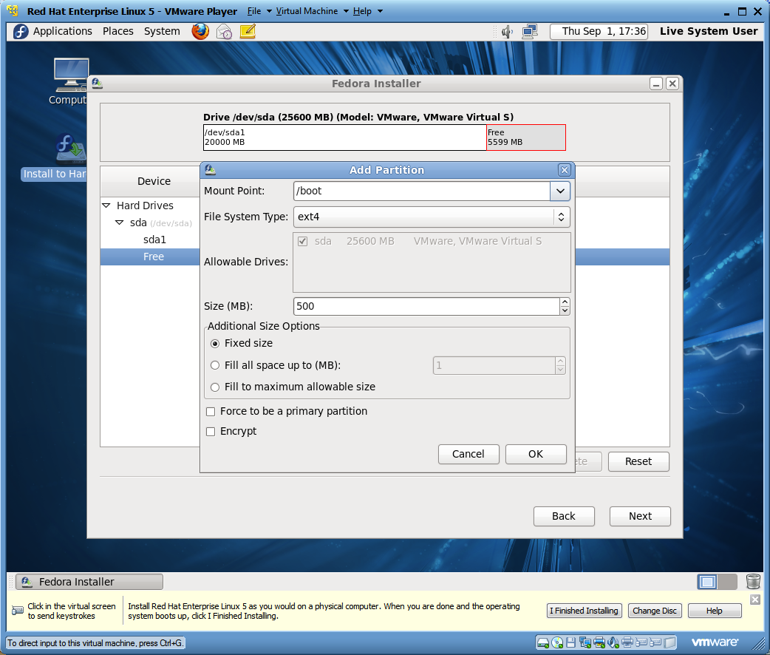
Editing the Boot Partition

Slide 41

Creating the Home Partition

Slide 42
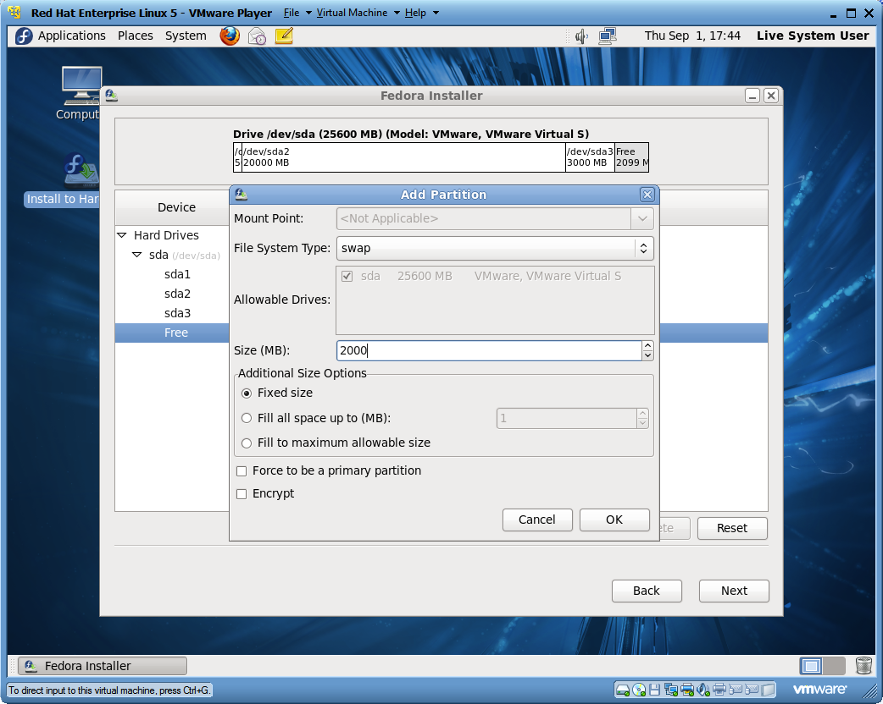
Creating a Swap Partition

Slide 43
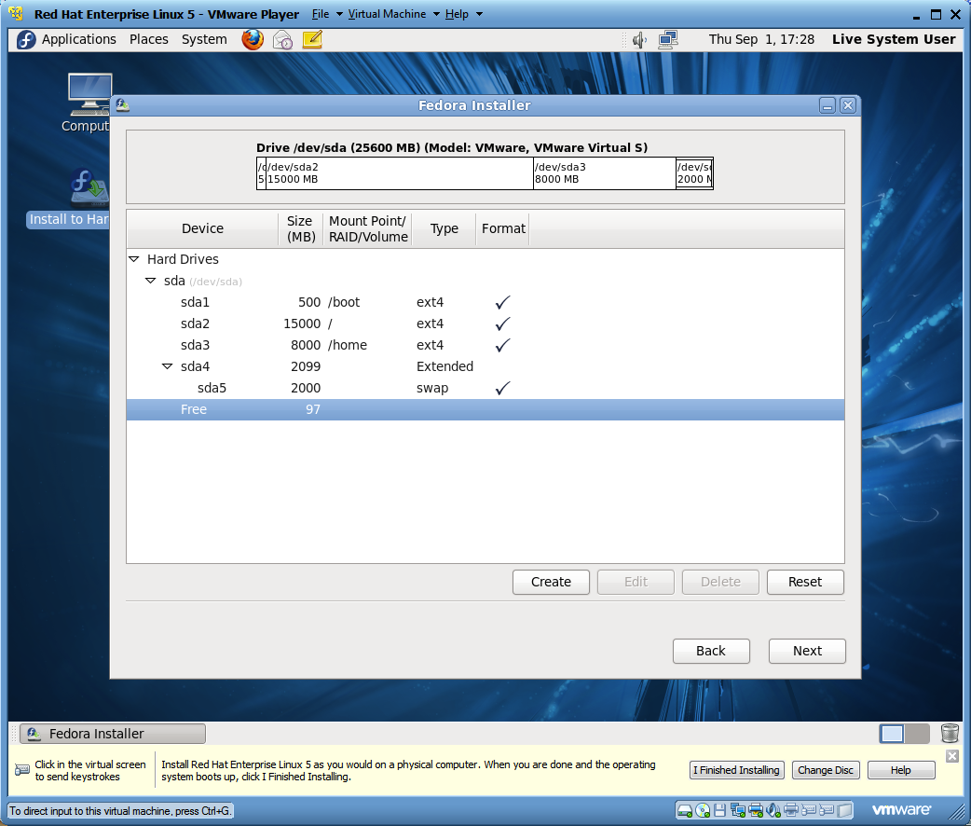
Review the Partition Layout

Slide 44
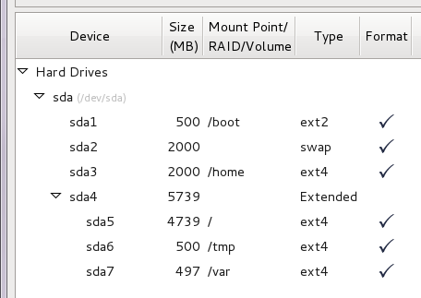
Alternate Partition Layout

Slide 45
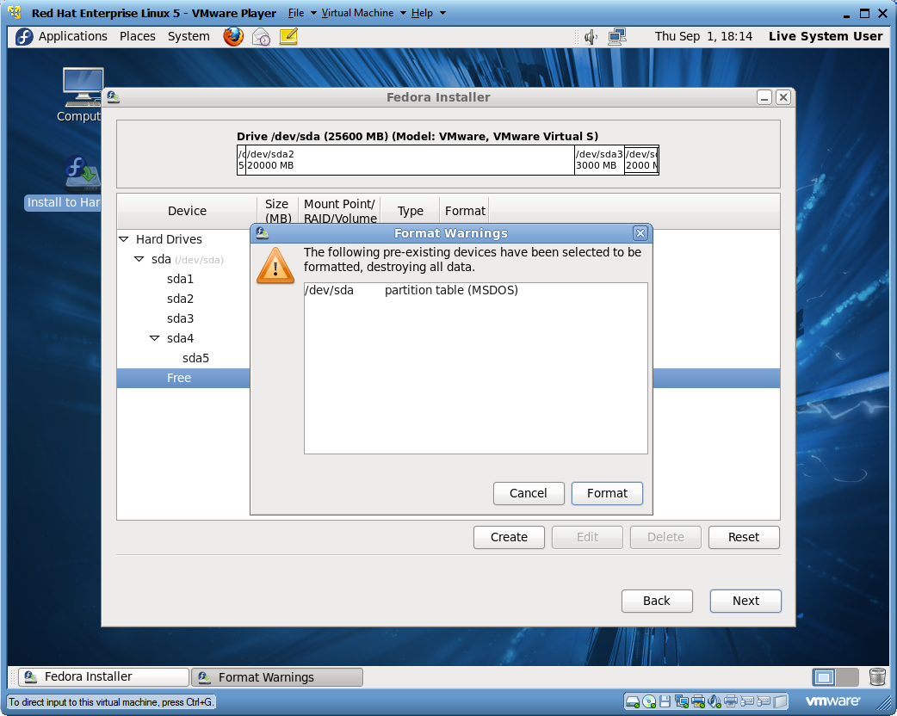
Partition Layout Warning

Slide 46
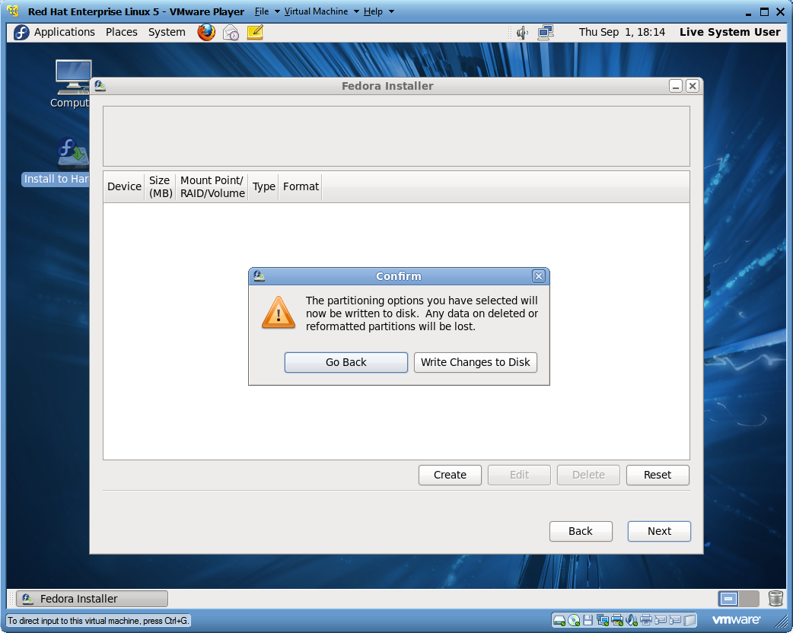
Partition Layout Confirmation

Slide 47
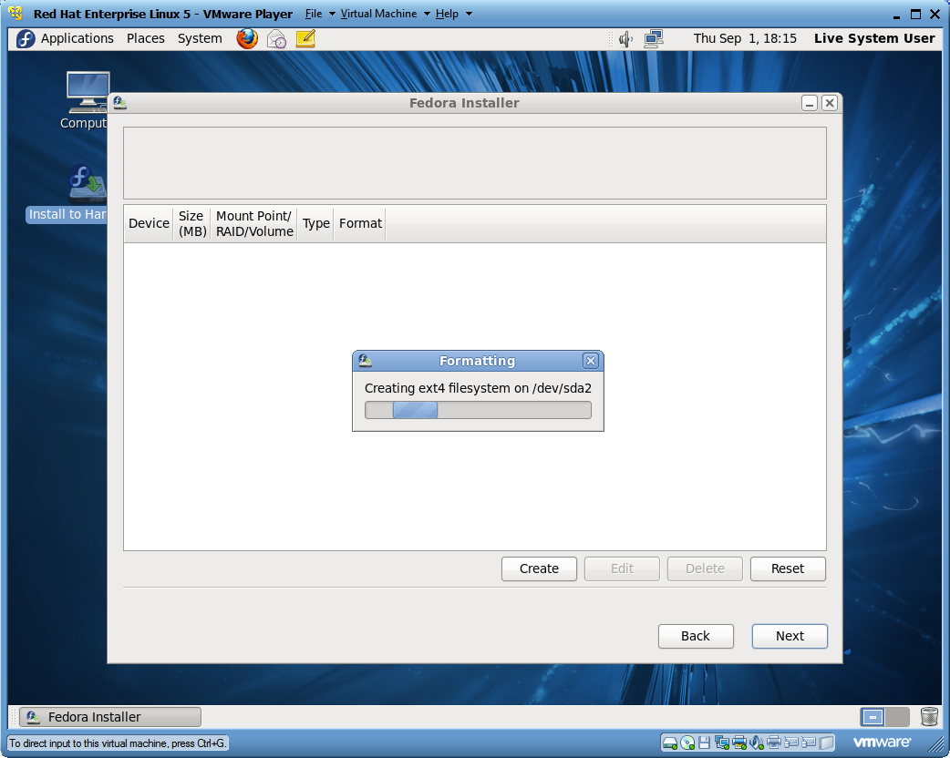
Creating the Partitions

Slide 48
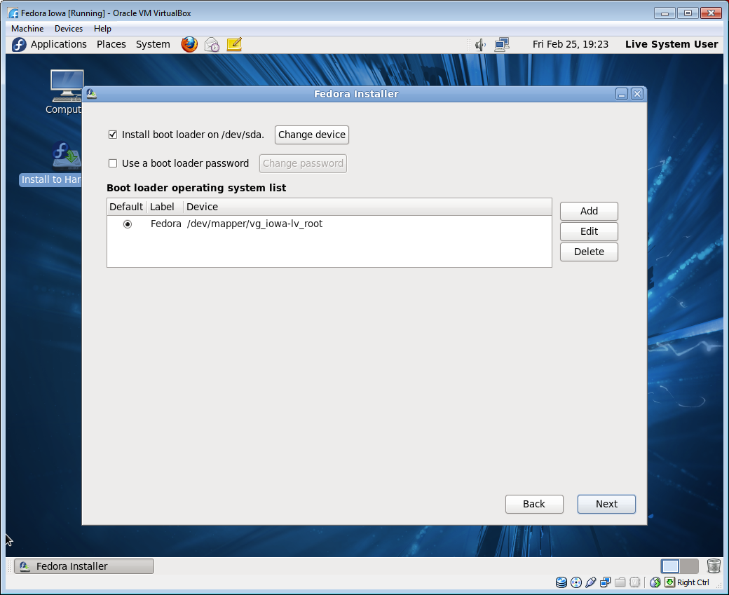
Installing the Boot Loader

Slide 49
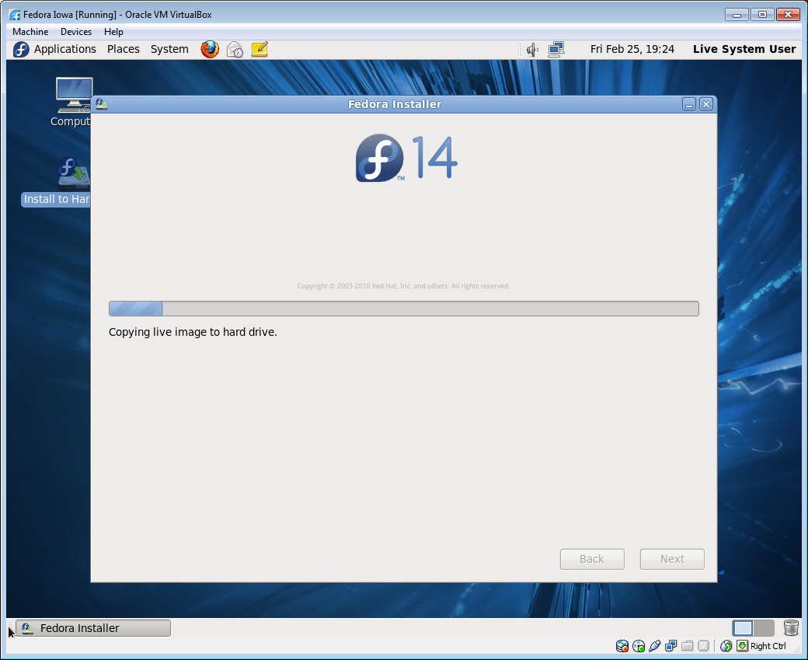
Copy Live Image to Hard Drive

Slide 50
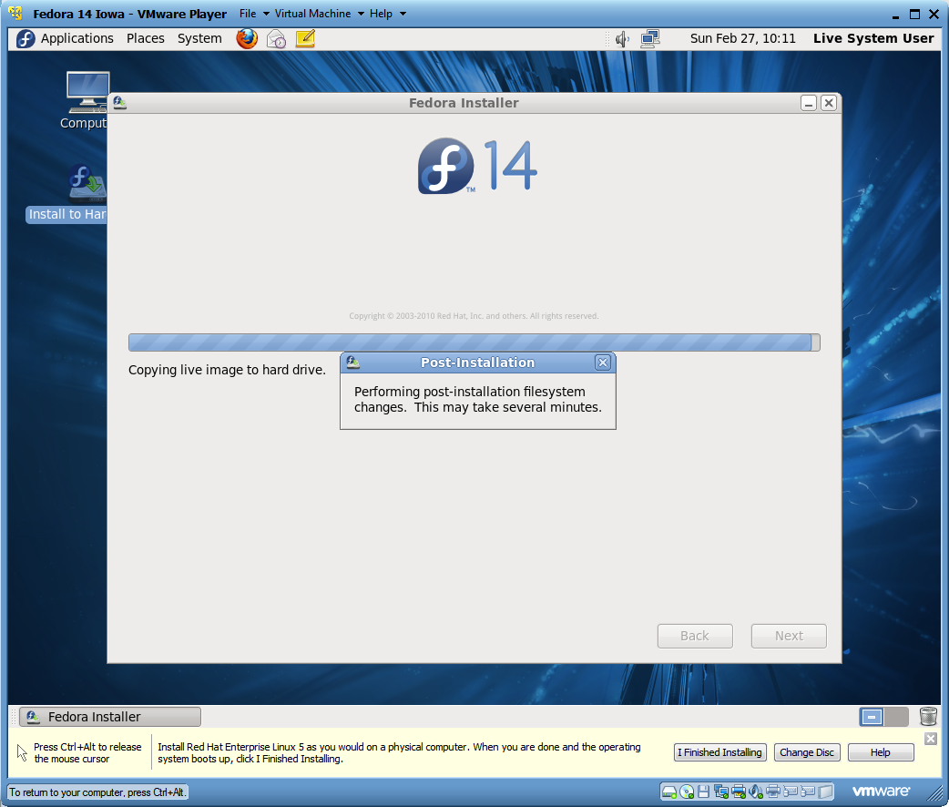
Live Image Post Installation

Slide 51
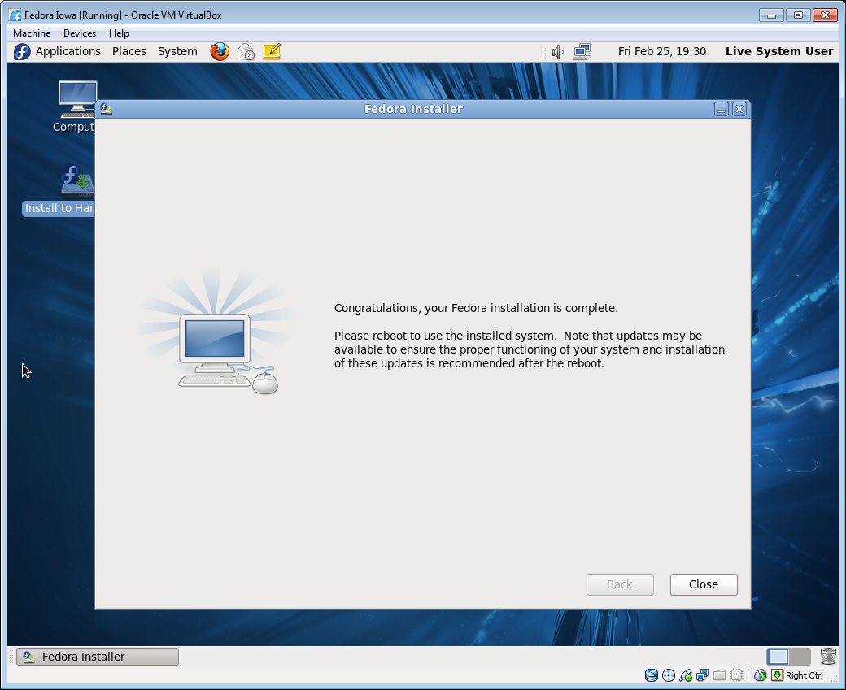
Installation Congratulations

Slide 52
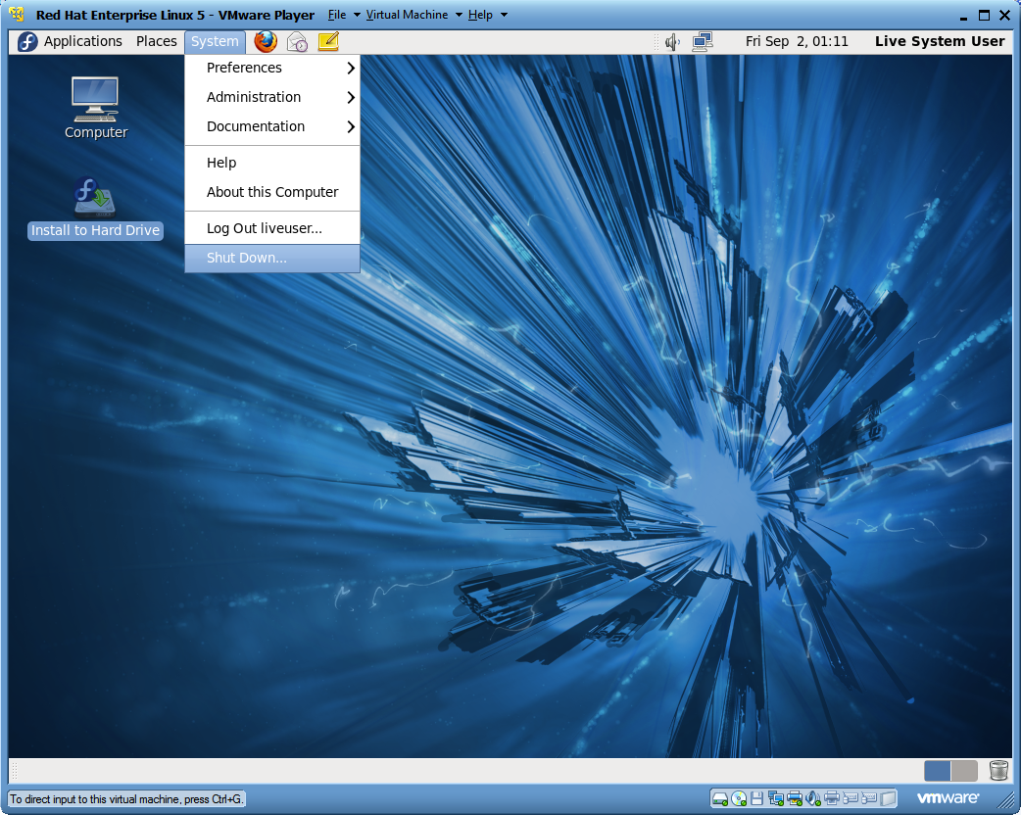
Shut Down Fedora

Slide 53
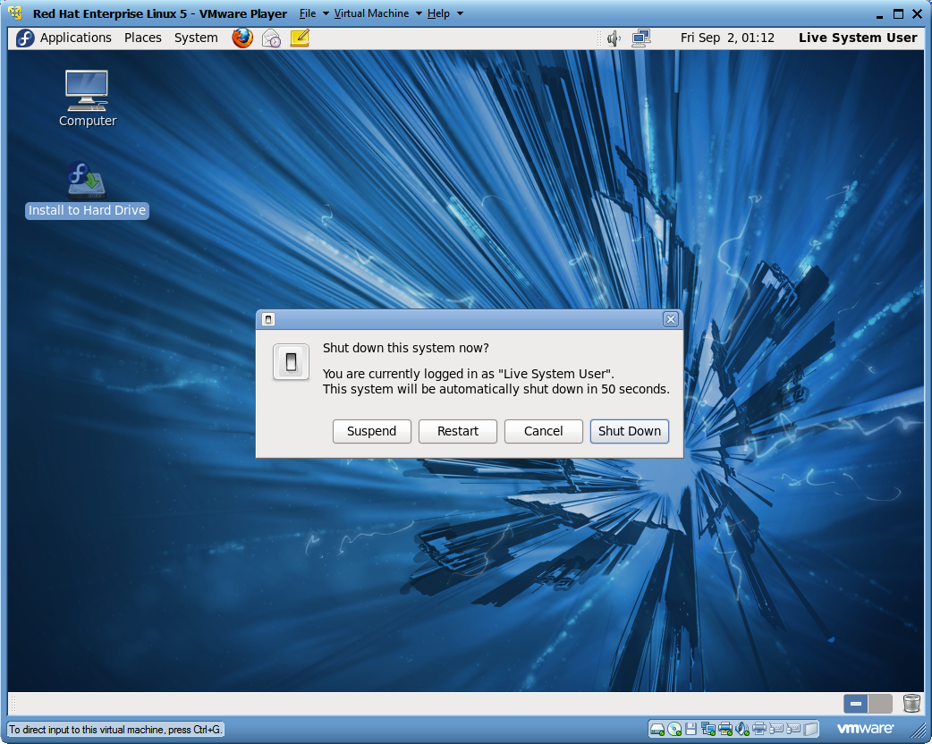
Shut Down Verification

Slide 54
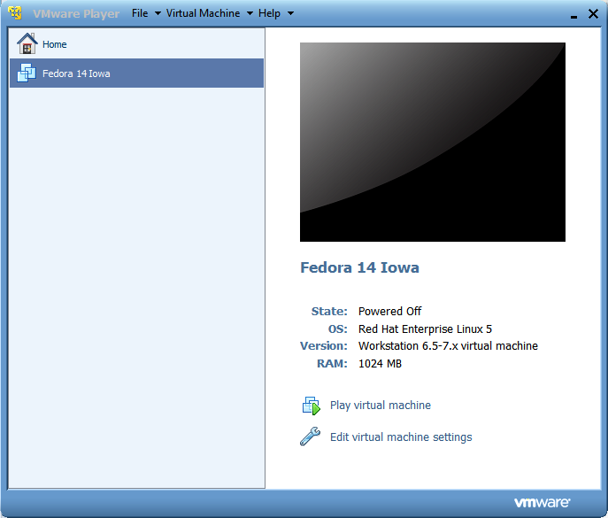
VMware Post Installation Setup

Slide 55
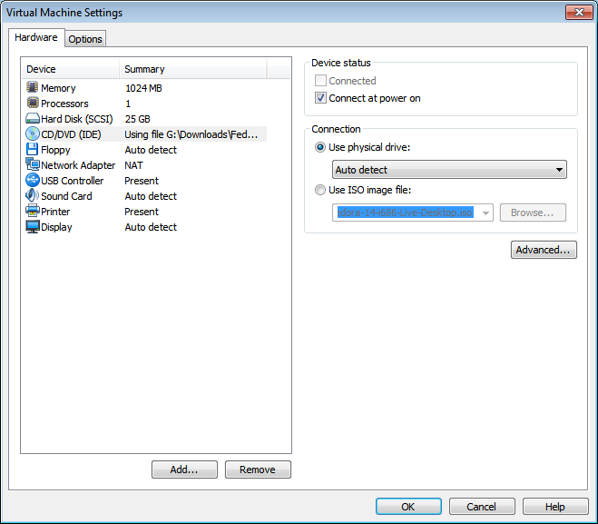
Physical Drive Connection

Slide 56
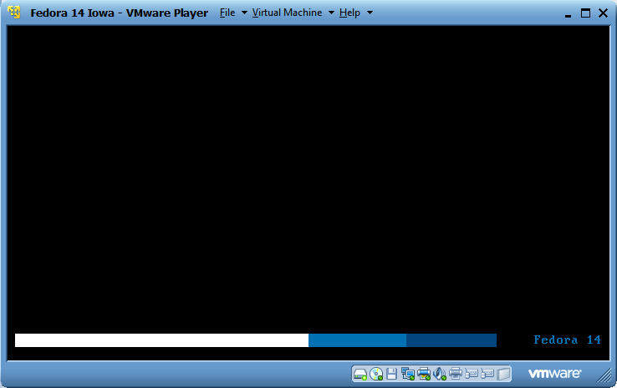
Hard Drive VMware Startup

Slide 57
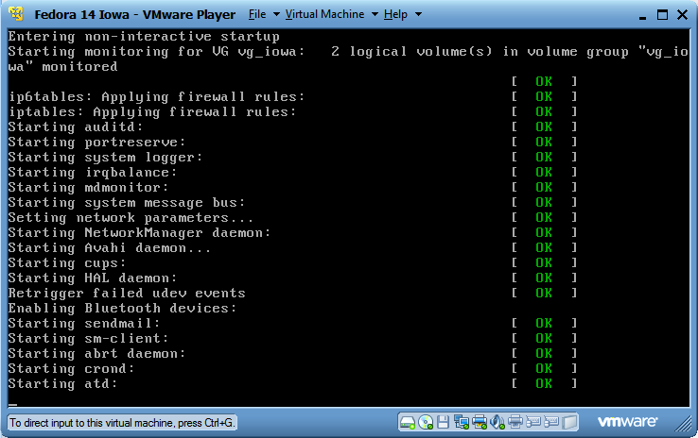
Daemon Startup

Slide 58
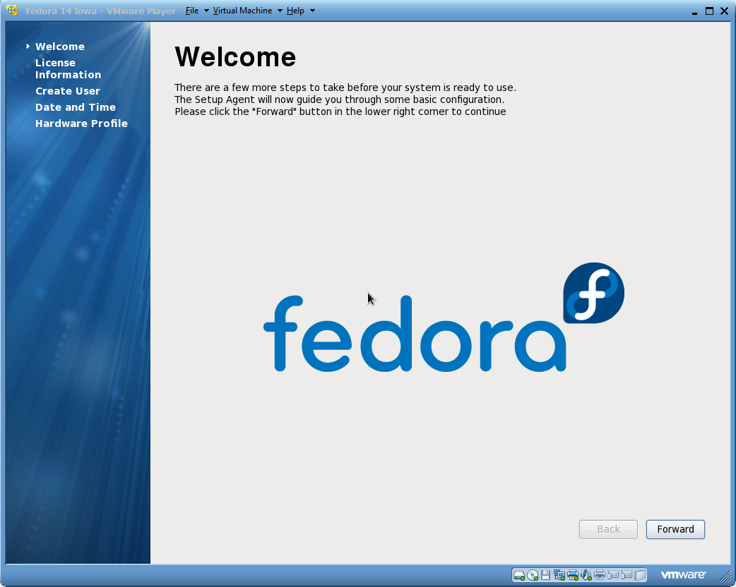
Configuration Welcome Screen

Slide 59
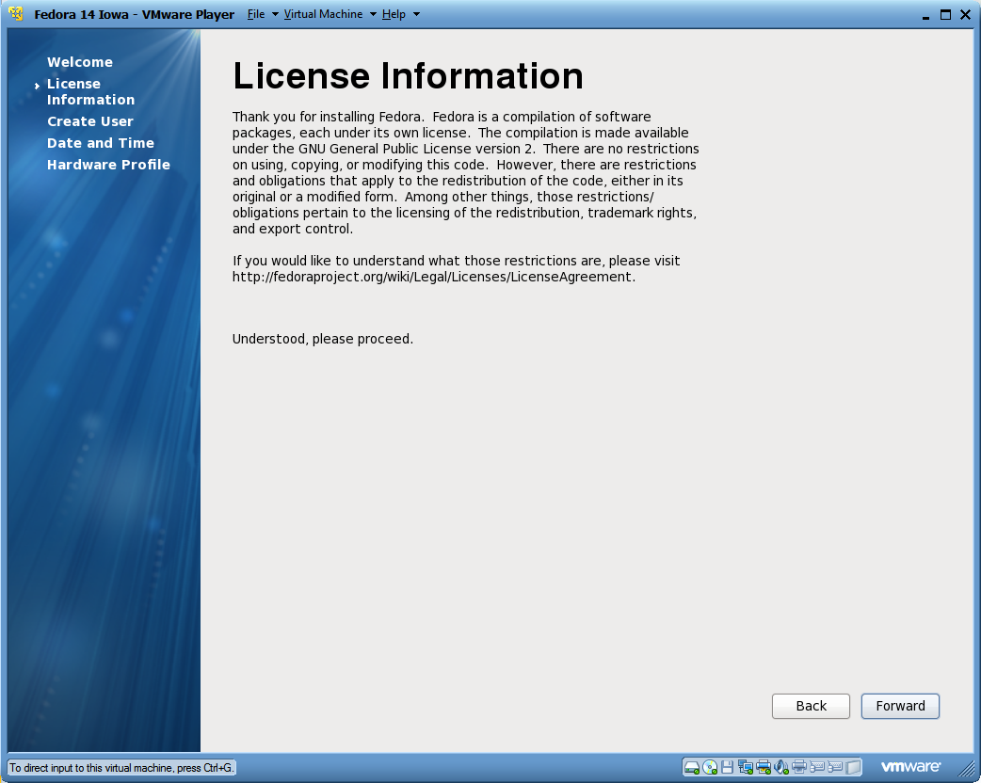
Fedora License Information

Slide 60
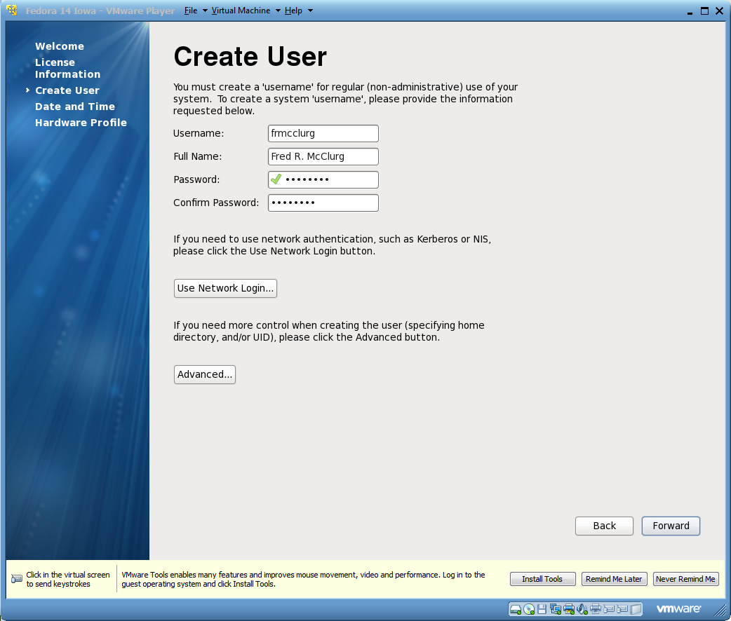
Create First User Account

Slide 61

Setting the Data and Time

Slide 62

Synchronizing the Date and Time

Slide 63

Hardware Profile Review

Slide 64

Hardware Profile Submission

Slide 65

Fedora Login Screen

Slide 66

Fedora User Account Login

Slide 67

Gnome Desktop

Slide 68
Interface Customization
Q: Which component of X Windows allows customization of the user interface?
Desktop Manager
Job Control
Window Manager
Mount Point

Slide 69

Launching a Linux Terminal

Slide 70

Granting sudo user access

Slide 71

Adding user to the sudoers file

Slide 72

Software updates

